Slide 1
PRMGT PRESENTATION
Project Management
UC3F1805CGD
Build:
RAM
ZAT
YIN
ANG

Slide 2
Case Study
Good Life Ptd. Ltd. (GL)
Role:
Project Management
Create
Us
(right now)
4 months left
Integrated Supply Chain Management Project (ISCMP)
18 issues atm

Slide 3
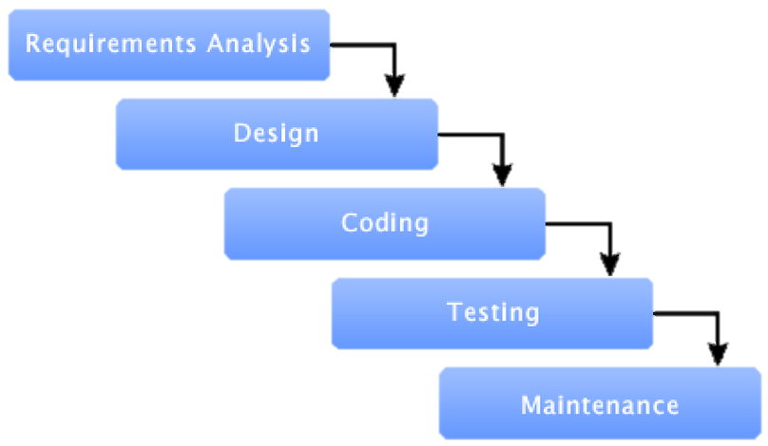
Project Methodology
Waterfall Model
All Processes are pre-defined
WHY?
Easy for similar projects
Assign roles in shorter time
Low risk

Slide 4
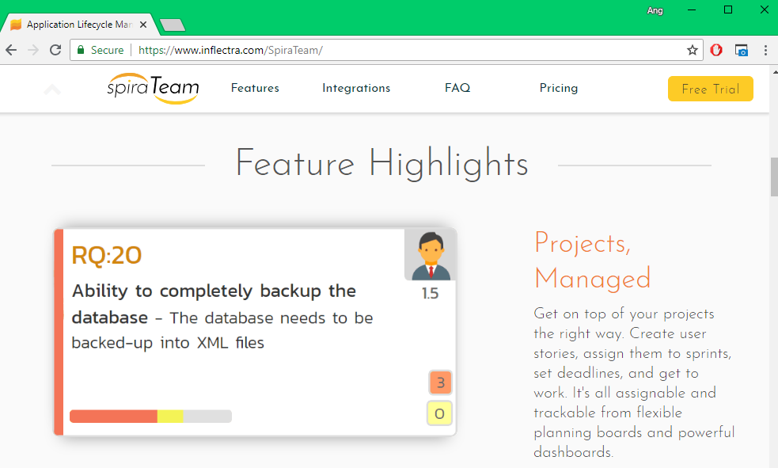
Project Methodology (cont.)
HOW?
SpiraTeam

Slide 5
(Areas Covered in this presentation)
Project Management Process
Knowledge Area(s)
Initiating
Planning
Executing
Monitoring & Controlling
Closing
Integration
Scope
Time
Cost
Quality
Human Resource
Communication
Risk
Procurement

Slide 6
Expected ‘Finish Date’ & ‘Budget Cost’
MILESTONES | DATE
Start Project | 11/6/2018
Receive Project Approval | 19/6/2018
Complete Planning Phase | 13/7/2018
Complete ISCMP Requirements | 24/7/2018
Complete ISCMP Development | 20/9/2018
Complete Testing | 9/10/2018
ISCMP Installation | 15/10/2018
Functional ICSMP | 22/10/2018
Project End | 30/10/2018
ESTIMATED BUDGET | $280,000.00
Hardware | $50,000.00
Development Software | $80,000.00
Manpower | $100,000.00
RESERVE | $50,000.00
Estimated Cost | $230,000.00

Slide 7
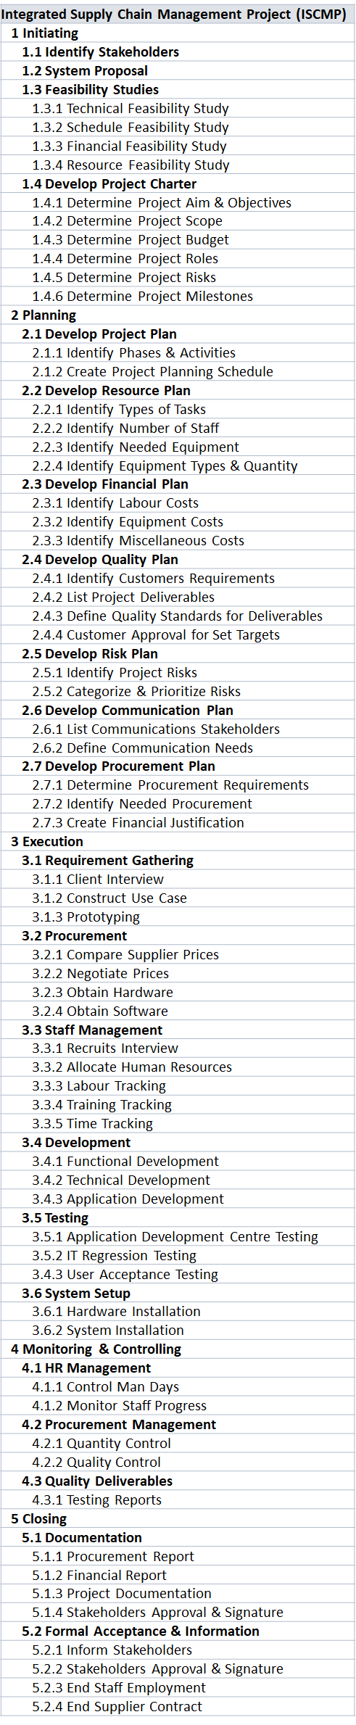
Work Breakdown Structure (WBS)
Initiating
Planning

Slide 8
Work Breakdown Structure (WBS)
Monitoring & Controlling
Execution
Closing

Slide 9
Scope Statement
Acceptance Criteria
Contains features in typical Supply Chain Management (SCM) Software
Inventory + Transportation + Yard + Labor + Warehouse managements
Deliverables
SCM software with centralized data warehouse that calculates faster.

Slide 10
Scope Statement (cont.)
Exclusions
Lack of security services
Capped logs duration
Limited access to current system(s)
Limited language available
Constraints
Time frames
Resources (hardware)
Activity performance
Assumptions
Advisors required for project team
Improvised hardware needed
Time management needed

Slide 11
Table of Issues (1)
Integration Management
Issue No. | Issues | Project Management Process | Tools & Technique
4 | The PC and server hardware technical specifications were constantly being changed to suit new or added requirements. | Planning | Expert Judgement: Get the latest and most powerful hardware technical specifications so the requirement to go for higher specifications would be very small change.
5 | Requirements keep coming in from users almost daily where the GITS-ADC Team Lead keeps on accepting them without hesitation. | Execution | Negotiations: Keep the requirements update monthly and inform the Team Lead to not take requirements when the team is already full of work.
15 | Technical skills were especially lacking in the network and security areas. | Planning | Group Decision-Making Techniques: Hiring a professional technical team to ensure all technical problems to assist with.

Slide 12
Table of Issues (2)
Human Resource Management
Issue No. | Issues | Project Management Process | Tools & Technique
6 | There was redundancy of work performed as the Work Breakdown Structure (WBS) was done separately by each respective department and the Project Manager did not review and then consolidate those WBSs into one wholistic WBS | Initiation | Pre-Assignment: Assigning teammates to work on tasks following the WBS and provide regular updates to the project manager.
7 | Most of the team members have been focusing more on their daily operation support rather than tasks being assigned by the Project Manager or their respective Team Lead | Execution | Performance Reviews: Conduct a daily check routine to ensure the project plan is being followed and ensure the team members are doing their task as provided.
13 | There was no clear project organizational structure to manage the project. | Planning | Organization Chart: With organization chart, clear organizational structure is developed start from the highest management till the individual responsibility.

Slide 13
Table of Issues (3)
Communication Management
Issue No. | Issues | Project Management Process | Tools & Technique
1 | The steering committee (which consist of the board of directors, CEO and Senior Managers of the organization) do not recall of being presented the project feasibility study by the Project Sponsor or the Project Manager to them. | Initiation | Communication Requirement Analysis: Determine all stakeholders means of communications, calling intervals and recommended timing plus the duration
6 | There was redundancy of work performed as the Work Breakdown Structure (WBS) was done separately by each respective department and the Project Manager did not review and then consolidate those WBSs into one wholistic WBS | Initiation; Planning | Meetings: Gathers the stakeholders for a face to face deliver more on the working requirements for a complete and centralized WBS. Issue Logs: Identify all issues that the project has and delegate manpower easier based on the problem-solving strategies’ comparison
7 | Most of the team members have been focusing more on their daily operation support rather than tasks being assigned by the Project Manager or their respective Team Lead | Execution | Performance Reporting: Conduct a daily-to-monthly check routine to ensure the project plan is being followed and ensure the team members are doing their task as provided.

Slide 14
Table of Issues (4)
Risk Management
Issue No. | Issues | Project Management Process | Tools & Technique
11 | The testing plan was not developed yet | Planning | Benchmarking: Pre-plan for 2 types of testing such as white-box testing and black-box testing. Also have phases on test on such as alpha phase, beta phase and so on.
12 | There was not even a clear designated sponsor (or sponsors) for the project. | Planning | Communication Technology: Ensure the stakeholders for the project before the project starts.
15 | Technical skills were especially lacking in the network and security areas. | Planning | Group Decision-Making Techniques: Hiring a professional technical team to ensure all technical problems to assist with.

Slide 15
Table of Issues (5)
Procurement Management
Issue No. | Issues | Project Management Process | Tools & Technique
9 | IT assets acquisition and spending were through PROC Manager with suppliers without going through a proper tendering process. | Execution | Inspections and Audits: Having inspections and audits to confirm supplies from suppliers.
10 | Purchasing of IT assets without a proper tendering process has led to overrun by budget. | Planning | Expert Judgement: Get the latest and most powerful hardware technical specifications so the requirement to go for higher specifications would be very small change.
18 | The hardware and software delivery were still being negotiated with some potential vendors while there were only four (4) months to complete the project. | Planning | Performance Reporting: Performance updates need to be provided to the project manager, the project manager will be able to handle the issues and updates needed to be provided to the stakeholders and the suppliers for the supplies.

Slide 16
Table of Issues (6)
Quality Management
Issue No. | Issues | Project Management Process | Tools & Technique
9 | IT assets acquisition and spending were through PROC Manager with suppliers without going through a proper tendering process. | Execution | Process Analysis: Conduct testing and checking the status to ensure the quality is top-notch.
15 | Technical skills were especially lacking in the network and security areas. | Planning | Group Decision-Making Techniques: Hiring a professional technical team to ensure all technical problems to assist with.
18 | The hardware and software delivery were still being negotiated with some potential vendors while there were only four (4) months to complete the project. | Planning | Design of Experiment: Testing is expected in the process, thus planning out the hardware and software that would be of use.

Slide 17
Table of Issues (7)
Scope Management
Issue No. | Issues | Project Management Process | Tools & Technique
2 | The project approval was not formally documented. | Initiation | Alternatives Identifications: Use multiple ways to confirm all approval and document them in hard copy as well as soft copy.
3 | There is no evidence that a proper project management process was followed. | Initiation | Inspection: Check all department and confirm all with evidence. Double confirm them if necessary.
14 | The Project Manager’s authority was constantly overridden by the department head managers. | Controlling & Monitoring | Variance Analysis: Keep all the department head managers under control, as well as keep them under monitor if there were anything wrong to happen.

Slide 18
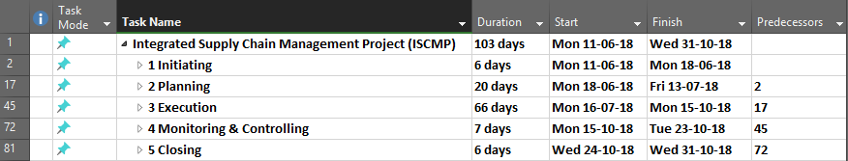
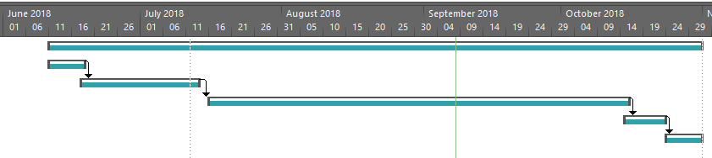
Gantt Chart (simplified ver.)

Slide 19
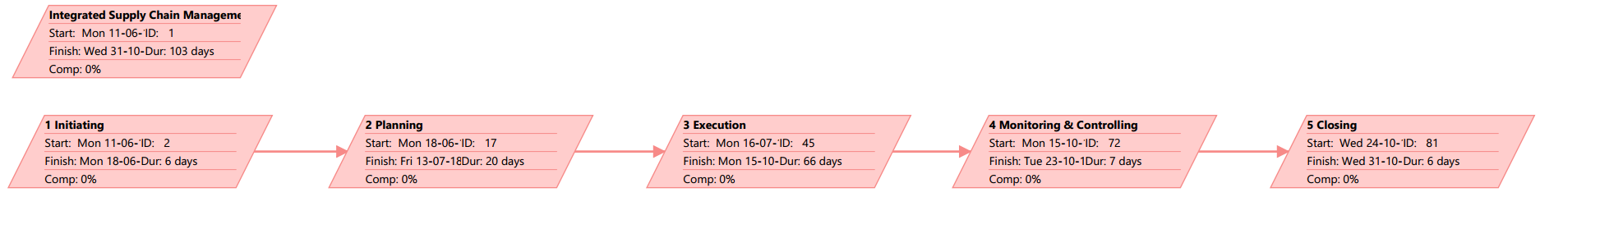
Network Diagram (also simplified ver.)

Slide 20
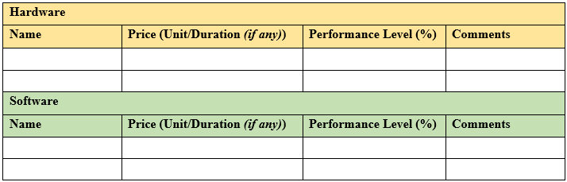
Quality Management Plan(1)
Issue 18: Hardware & Software Delivery still in Negotiations
Planning
Design of Experiments
‘comparing hardware and software performance relative to pricing in ISCMP’

Slide 21
Quality Management Plan(2)
Issue 9: IT assets spending lack proper Tendering Process
Assurance
Process Analysis
7 steps of Tendering
Determine Tendering Types
Prepare Request for Tendering
Inviting Tenders
Response from Suppliers
Evaluation & Selection
Notification & Debriefing
Establish & Manage Contracts

Slide 22
Quality Management Plan(3)
Issue 15: Lacking Network & Security-based skills
Control
Group Decision-Making Techniques
Brainstorming
+ Expert Judgement (guide & evaluation)
TOPIC: Requirements of ISCMP Network & Security parts

Slide 23
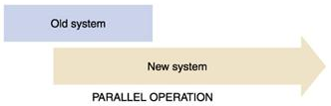
Cutover Strategy & Transition Plan
Parallel Operation
New system added
while old system still running
WHY?
ISCMP == Critical Application
Totally different core database compared to old system
HOW?
Old system: Placeholder Backup
New System: Practical Training + User Acceptance Test

Slide 24
Lesson Learned Report
(Individual Parts)

Slide 25
Human Resource Management (1)
Issue 6: WBS was done separately by each department
PLAN
Pre-Assignment
Assign team members to work on tasks according to the WBS by HRM
Have team members provide regular updates to the project manager

Slide 26
Human Resource Management (2)
Issue 7: Focusing on daily operation instead of Project Manager’s assigned tasks
MANAGE
Performance Reviews
Conduct daily check routine on team members
Ensure project plan is followed

Slide 27
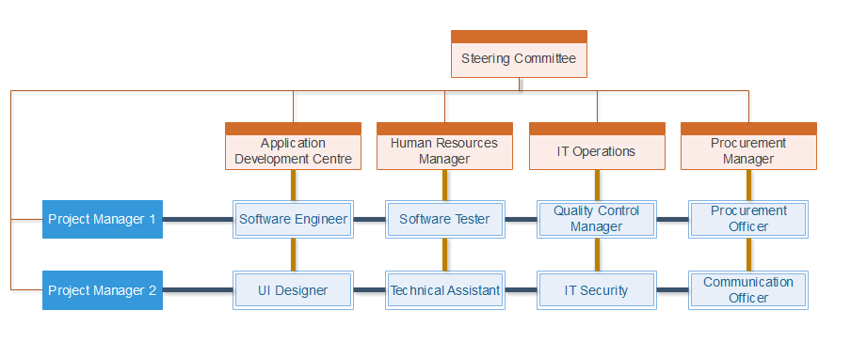
Human Resource Management (3)
Issue 13: No clear organizational structure
PLAN
Organization chart
Clear organizational chart
In matrix form

Slide 28
Procurement Management (1)
Issue 9: IT assets acquisition lack proper Tendering Process
EXECUTION
Inspections & Audits
To confirm supplies from the suppliers/sponsors

Slide 29
Procurement Management (2)
Issue 10: Budget overrun due to IT Assets Purchases without proper tendering processes
PLANNING
Expert Judgement
Get the latest/most powerful hardware technical specifications computer
Minimize changes for higher specifications/requirements

Slide 30
Procurement Management (3)
Issue 18: Hardware & Software Delivery still in Negotiations while there’s only 4 months left
PLANNING
Performance Reporting
Performance updates need to be provided to the project manager, the project manager will be able to handle the issues and updates needed to be provided to the stakeholders and the suppliers for the supplies.

Slide 31
Communication Management(1)
Issue 1: Steering Committee didn’t recall of feasibility study presentation
PLAN
Communication Requirements Analysis
Understand everyone’s contacts
Prevent ‘hit-and-miss’ scenarios
e.g.
STAKEHOLDER NAME | ROLE(S) | DOCUMENT (NAME & FORMAT) | AVAILABLE IN (PLATFORM) | CONTACT BY (DEADLINE)
Monos Krome | Quality Control | Progress Report (Printed Copy) | Face-to-Face; WeChat | Each week, Thursday
Lunaire Mun | UI (User Interface) Designer | User Interface Design Draft (.ai Format & Printed Copy) | E-mail; Face-to-Face | 24/7/2018
Apolloa Sun | Software Engineer | Status Report (E-mail) | Discord; E-mail; LINE | Each week, Monday

Slide 32
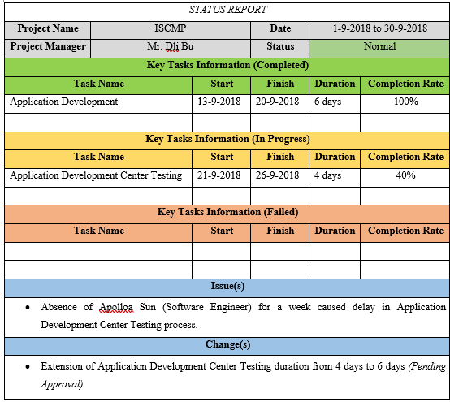
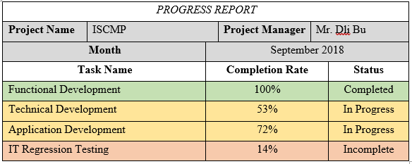
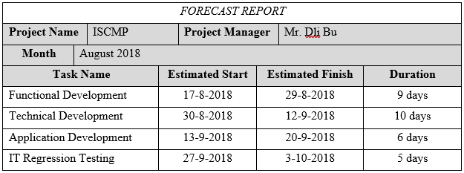
Communication Management(2)
Issue 7: Wrong priority levels among team members
MANAGE
Performance Reporting
1 representative from each section
Monthly intervals
Status Report + Progress Report + Forecast

Slide 33
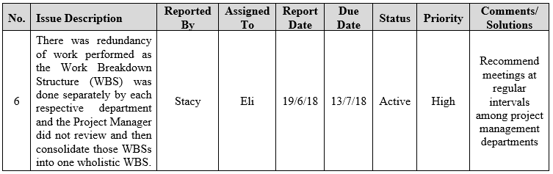
Communication Management(3)
Issue 6: WBS are all separated & not complete
CONTROL
Issue Logs + Meeting
Issue Log: provide meeting guidelines
Meeting: deliver tasks & report issue log progress

Slide 34
Risk Management(1)
Issue 11: The testing plan was not developed yet
PLAN
Benchmarking
Pre-plan white-box testing and black-box testing
Have multiple testing phases such as alpha phase, beta phase and so on.

Slide 35
Risk Management(2)
Issue 12: There was no clear designated sponsor(s) for the project
MANAGE
Communication Technology
Ensure the stakeholders for the project before the project starts
Prepare better proposal or look for other sponsors

Slide 36
Risk Management(3)
Issue 15: Lacking technical skills in network and security areas
CONTROL
Group Decision-Making Techniques
Hiring a professional technical team to assist on the problem.
Outsource modules to vendors

Slide 37
Conclusion
By taking over the project half way, with due respected time provided of 4 months, we did our best to complete the project by analyzing the issues that were left by the previous team and the upcoming issues that were foreseen.

Slide 38
* Hah, we won’t question you. We’ll only doubt you.
Q & A
*

